Slide 1
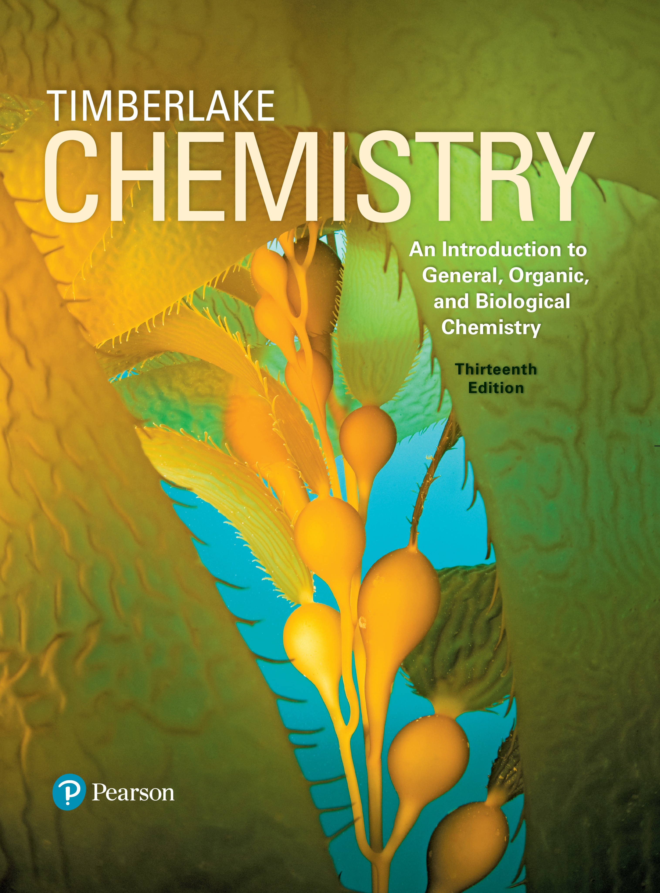
Chemistry: An Introduction to General, Organic, and Biological Chemistry
Thirteenth Edition
Chapter 10
Acids and Bases and Equilibrium
Copyright © 2018, 2015, 2012 Pearson Education, Inc. All Rights Reserved
Notes:
If this PowerPoint presentation contains mathematical equations, you may need to check that your computer has the following installed:
1) MathType Plugin
2) Math Player (free versions available)
3) NVDA Reader (free versions available)

Slide 2
Acids and Bases and Equilibrium
Clinical laboratory technicians prepare specimens for the detection of cancerous tumors and type blood samples for transfusions. They must also interpret and analyze the test results, which are then passed on to the physician.

Slide 3
10.1 Acids and Bases
The term acid comes from the Latin word acidus, which means “sour.” We are familiar with the sour taste of vinegar and lemons and other common acids in foods. Citrus fruits are sour because they contain acids.
Learning Goal Describe and name acids and bases.

Slide 4
Acids
Arrhenius acids
produce hydrogen ions
ions when they dissolve in
water
are also electrolytes because they produce
in water
have a sour taste
turn blue litmus red
corrode some metals

Slide 5
Naming Acids
Acids with a hydrogen ion
and a nonmetal
ion are named with the prefix hydro and end with ic acid.
H C l hydrochloric acid
Acids with a hydrogen ion
and a polyatomic ion are
named by changing the end of the name of the polyatomic ion from
ate to ic acid | or | ite to ous acid
C l O sub 3 super minus chlorate | or | C l O sub 2 super minus chlorite
H C l O sub 3 chloric acid | or | H C l O sub 2 chlorous acid

Slide 6
Names of Common Acids
Table 10.1 Names of Common Acids and Their Anions
Acid | Name of Acid | Anion | Name of Anion
H C l | Hydrochloric acid | ^{C l super minus} | Chloride
H B r | Hydrobromic acid | ^{B r super minus} | Bromide
H I | Hydroiodic acid | ^{I super minus} | Iodide
H C N | Hydrocyanic acid | ^{C N super minus} | Cyanide
_{H N O sub 3} | Nitric acid | ^{N O sub 3 super minus} | Nitrate
_{H N O sub 2} | Nitrous acid | ^{N O sub 2 super minus} | Nitrite
_{H sub 2 S O sub 4} | Sulfuric acid | S O 4 2 minus | Sulfate
_{H sub 2 S O sub 3} | Sulfurous acid | S O 3 2 minus | Sulfite
_{H sub 2 C O sub 3} | Carbonic acid | C O 3 2 minus | Carbonate
_{H C sub 2 H sub 3 O sub 2} | Acetic acid |  | Acetate
_{H sub 3 P O sub 4} | Phosphoric acid | P O 4 3 minus | Phosphate
_{H sub 3 P O sub 3} | Phosphorous acid | P O 3 3 minus | Phosphite
_{H C l O sub 3} | Chloric acid | ^{C l O sub 3 super minus} | Chlorate
_{H C I O sub 2} | Chlorous acid | ^{C l O sub 2 super minus} | Chlorite

Slide 7
Learning Check 1
Select the correct name for each of the following acids:
H B r
A. bromic acid
B. bromous acid
C. hydrobromic acid
A. carbonic acid
B. hydrocarbonic acid
C. carbonous acid
A. bromic acid
B. hydrobromous acid
C. bromous acid

Slide 8
Solution 1
H B r
C. hydrobromic acid
The name of an acid with a hydrogen ion
nonmetal uses the prefix hydro and ends with ic acid.
A. carbonic acid
An acid with a hydrogen ion
and a polyatomic ion
ending in ate is called an ic acid.
C. bromous acid
An acid with a hydrogen ion
and a polyatomic ion
ending in ite is called an ous acid.

Slide 9
Bases
Arrhenius bases
produce hydroxide ions
in water
taste bitter or chalky
are also electrolytes because they produce hydroxide ions
in water
feel soapy and slippery
turn litmus indicator paper blue and phenolphthalein indicator pink

Slide 10
Naming Bases
Typical Arrhenius bases are named as hydroxides.
N a O H
sodium hydroxide
K O H
potassium hydroxide
barium hydroxide
aluminum hydroxide

Slide 11
Learning Check 2
Match the formulas with the names.
Fill in the blank
A. iodic acid
Fill in the blank
B. sulfuric acid
Fill in the blank
C. sodium hydroxide
Fill in the blank
D. nitrous acid
Fill in the blank N a O H
E. calcium hydroxide

Slide 12
Solution 2
Match the formulas with the names.
D
D. nitrous acid
E
E. calcium hydroxide
B
B. sulfuric acid
A
A. iodic acid
C N a O H
C. sodium hydroxide

Slide 13
Characteristics of Acids and Bases
Table 10.2 Some Characteristics of Acids and Bases
Characteristic | Acids | Bases
Arrhenius | Produce H super plus | Produce O H super minus
Electrolyte | Yes | Yes
Taste | Sour | Bitter, chalky
Feel | May sting | Soapy, slippery
Litmus | Red | Blue
Phenolphthalein | Colorless | Pink
Neutralization | Neutralize bases | Neutralize acids

Slide 14
Learning Check 3
Identify each as a characteristic of
A. an acid
or
B. a base
Fill in the blank
has a sour taste
Fill in the blank
produces
in aqueous solutions
Fill in the blank
has a chalky taste
Fill in the blank
is an electrolyte
Fill in the blank
produces
in aqueous solutions

Slide 15
Solution 3
Identify each as a characteristic of
A. an acid
or
B. a base
A
has a sour taste
B
produces
in aqueous solutions
B
has a chalky taste
A, B
is an electrolyte
A
produces
in aqueous solutions

Slide 16
10.2 Brønsted–Lowry Acids and Bases
According to the Brønsted–Lowry theory,
an acid is a substance that donates
a base is a substance that accepts
Learning Goal Identify conjugate acid–base pairs for Brønsted–Lowry acids and bases.
Notes:
Water bonds with a hydrogen ion, H plus, to produce a hydronium ion with the following Lewis structure. A central O atom with 1 lone pair is single bonded to 3 H atoms, to the left, below, and to the right. A bracket encases the entire structure and shows a superscripted plus sign after the right bracket.

Slide 17
N H sub 3, A Brønsted–Lowry Base
In the reaction of ammonia and water,
acts as the base that accepts
acts as the acid that donates

Slide 18
Learning Check 1
In each of the following equations, identify the Brønsted–Lowry acid and base in the reactants:
A.
B.

Slide 19
Solution 1
In each of the following equations, identify the Brønsted–Lowry acid and base in the reactants:
A.
B.

Slide 20
Conjugate Acid–Base Pairs (1 of 3)
In any acid–base reaction, there are two conjugate acid–base pairs, and
each pair is related by the loss and gain of
one pair occurs in the forward direction
one pair occurs in the reverse direction

Slide 21
Conjugate Acid–Base Pairs (2 of 3)
In this acid–base reaction,
the first conjugate acid–base pair is
H F, which donates
to form its
conjugate base,
the other conjugate acid–base pair
which accepts
to form
its conjugate acid,
each pair is related by a loss and
gain of
Notes:
H F, aqueous, + H sub 2 O, liquid, yields F super minus, aqueous, + H sub 3 O super plus, aqueous. H F is an acid which loses H super plus in the forward reaction to form conjugate base F super minus. F super minus gains H super plus in the reverse reaction. H sub 2 O is a base which gains H plus in the forward reaction to form conjugate acid H sub 3 O super plus. H sub 3 O super plus loses H super plus in the reverse reaction.

Slide 22
Conjugate Acid–Base Pairs (3 of 3)
In the reaction of
one conjugate acid–base pair is
the other conjugate acid–base pair is

Slide 23
Learning Check 2
Write the conjugate base for each of the following acids:
A. H B r
B.
C.
Write the conjugate acid for each of the following bases:
A.
B.
C.

Slide 24
Solution 2 (1 of 2)
Write the conjugate base for each of the following acids:
A.
B.
C.

Slide 25
Solution 2 (2 of 2)
Write the conjugate acid for each of the following: Add an
to each base to get the conjugate acid.
A.
B.
C.

Slide 26
Learning Check 3
Identify the sets that contain acid–base conjugate pairs.
1.
2.
3.
4.
5.

Slide 27
Solution 3
Identify the sets that contain acid–base conjugate pairs.
1.
acid, conjugate base
2.
not acid–base conjugate pair
3.
not acid–base conjugate pair
4.
base, conjugate acid
5.
base, conjugate acid

Slide 28
Learning Check 4
Identify the conjugate acid–base pairs in the following reaction:

Slide 29
Solution 4 (1 of 2)
Identify the conjugate acid–base pairs in the following reaction:
Analyze the Problem | Given | Given | Need | Connect
Analyze the Problem | H N O sub 3 N H sub 3 | N O sub 3 super minus, N H sub 4 super plus | Conjugate acid-base pairs | lose/gain one H super plus
Step 1 Identify the reactant that loses
as the acid.
In the reaction,
is the acid and
is its conjugate base

Slide 30
Solution 4 (2 of 2)
Identify the conjugate acid–base pairs in the following reaction:
Step 2 Identify the reactant that gains
as the base.
In the reaction,
is the base and
is its conjugate acid
Step 3 Write the conjugate acid–base pairs.
is the acid and its conjugate base.
is the base and its conjugate acid.

Slide 31
10.3 Strengths of Acids and Bases
Weak acids only partially dissociate in water.
Hydrofluoric acid (H F) is the only halogen acid that is a weak acid.
Learning Goal Write equations for the dissociation of strong and weak acids and bases.

Slide 32
Strong and Weak Acids (1 of 2)
A strong acid completely ionizes (100%) in aqueous solutions.
A weak acid dissociates only slightly in water to form a few ions in aqueous solutions.

Slide 33
Strong Acids (1 of 2)
In water, the dissolved molecules of H A, a strong acid,
dissociate into ions 100%
give large concentrations of

Slide 34
Strong Acids (2 of 2)
There are six common strong acids. They have weak conjugate bases.
Table 10.3 Relative Strengths of Acids and Bases
Notes:
Progression from bottom to top shows increasing acid strength, Strong acids are as follows.
Acid name Acid formula
Hydroiodic acid H I
Hydrobromic acid H B r
Perchloric acid H C l O 4
Hydrochloric acid H C l
Sulfuric acid H 2 S O 4
Nitric acid H N O 3
Hydronium ion H 3 O plus
Weak acids are as follows.
Acid name Acid formula
Hydrogen sulfate ion H S O 4, minus
Phosphoric acid H 3 P O 4
Nitrous acid H N O 2
Hydrofluoric acid H F
Acetic acid H C 2 H 3 O 2
Carbonic acid H 2 C O 3
Hydro sulfuric acid H 2 S
Dihydrogen phosphate ion H 2 P O 4, minus
Ammonium ion N H 4, plus
Hydrocyanic acid H C N
Bicarbonate ion H C O 3, minus
Methylammonium ion C H 3 N H 3, plus
Hydrogen phosphate ion H P O 4, 2 minus
Water H 2 O

Slide 35
Weak Acids (1 of 2)
In weak acids,
only a few molecules dissociate
most of the weak acid remains as the undissociated (molecular) form of the acid
the concentrations of the
and the anion

Slide 36
Weak Acids (2 of 2)
Weak acids
make up most of the acids
have strong conjugate bases
Table 10.3 Relative Strengths of Acids and Bases
Notes:
Progression from bottom to top shows increasing acid strength, Strong acids are as follows.
Acid name Acid formula
Hydroiodic acid H I
Hydrobromic acid H B r
Perchloric acid H C l O 4
Hydrochloric acid H C l
Sulfuric acid H 2 S O 4
Nitric acid H N O 3
Hydronium ion H 3 O plus
Weak acids are as follows.
Acid name Acid formula
Hydrogen sulfate ion H S O 4, minus
Phosphoric acid H 3 P O 4
Nitrous acid H N O 2
Hydrofluoric acid H F
Acetic acid H C 2 H 3 O 2
Carbonic acid H 2 C O 3
Hydro sulfuric acid H 2 S
Dihydrogen phosphate ion H 2 P O 4, minus
Ammonium ion N H 4, plus
Hydrocyanic acid H C N
Bicarbonate ion H C O 3, minus
Methylammonium ion C H 3 N H 3, plus
Hydrogen phosphate ion H P O 4, 2 minus
Water H 2 O

Slide 37
Strong and Weak Acids (2 of 2)
In an H C l solution, the strong acid H C l dissociates 100% to form
A solution of the weak
mostly molecules of
and a few ions
Notes:
The molecular view of the weak acid, H C 2 H 3 O 2, shows most molecules remain intact. Only one molecule of the 10 shown, separate into the ions, resulting in one H 3 O plus ion and one C 2 H 3 O 2, minus ion.

Slide 38
Strong Bases
Strong bases
are formed from metals of Groups 1A (1) and 2A (2)
include L i O H, N a O H, K O H,
dissociate completely in water

Slide 39
Weak Bases
Weak bases
Weak electrolytes
include
Produce few ions in solution

Slide 40
Learning Check 1
Identify each of the following as a strong or weak acid or base:
A. H B r
B.
C. N a O H
D.
E.

Slide 41
Solution 1
Identify each of the following as a strong or weak acid or base:
A. H B r
strong acid
B.
weak acid
C. N a O H
strong base
D.
strong acid
E.
weak base

Slide 42
Learning Check 2
Using Table 10.3, identify the stronger acid in each pair.
A.
B.
C.

Slide 43
Solution 2
Using Table 10.3, identify the stronger acid in each pair.
A.
is the stronger acid.
B.
H B r is the stronger acid.
C.
is the stronger acid.

Slide 44
10.4 Acid–Base Equilibrium
Oxygen transport involves an equilibrium between hemoglobin (H b), oxygen, and
Hypoxia may occur at high altitudes with a lower oxygen concentration.
Learning Goal Use the concept of reversible reactions to explain acid–base equilibrium. Use Le Châtelier’s principle to determine the effect on equilibrium concentrations when reaction conditions change.

Slide 45
Equilibrium (1 of 2)
In an equilibrium reaction,
two reactions are taking place
a reversible reaction proceeds in both the forward and reverse directions
Forward reaction:
Reverse reaction:

Slide 46
Equilibrium (2 of 2)
Equilibrium is reached when
there are no further changes in the concentrations of reactants and products
the rate of the forward reaction is equal to the rate of the reverse reaction
Notes:
Plots are as follows.
• A plot representing a decrease in the concentration of reactants falls from the y axis with decreasing steepness then extends horizontally.
• A plot representing an increase in the concentration of products rises from the origin with decreasing steepness, above the plot for reactants, then extends horizontally beginning at the same point on the x axis where the plot for reactants becomes horizontal.
The point where both plots extend horizontally represents equilibrium reached.

Slide 47
Learning Check 1
Complete each of the following with equal or not equal, faster or slower, or change or do not change:
A. Before equilibrium is reached, the concentrations of the reactants and products Fill in the blank.
B. Initially, reactants have a rate of reaction Fill in the blank than the rate of reaction of the products.
C. At equilibrium, the rate of the forward reaction is Fill in the blank to the rate of the reverse reaction.
D. At equilibrium, the concentrations of the reactants and products Fill in the blank.

Slide 48
Solution 1
Complete each of the following with equal or not equal, faster or slower, or change or do not change:
A. Before equilibrium is reached, the concentrations of the reactants and products change.
B. Initially, reactants have a rate of reaction faster than the rate of reaction of the products.
C. At equilibrium, the rate of the forward reaction is equal to the rate of the reverse reaction.
D. At equilibrium, the concentrations of the reactants and products do not change.

Slide 49
Le Châtelier’s Principle (1 of 2)
When we alter the concentration of a reactant or product of a system at equilibrium,
the rates of the forward and reverse reactions will no longer be equal
a stress is placed on the equilibrium
Le Châtelier’s principle states that when equilibrium is disturbed, the rates of the forward and reverse reactions change to relieve that stress and reestablish equilibrium.

Slide 50
Le Châtelier’s Principle (2 of 2)
Notes:
Each set contains 2 tanks, A and B, connected by a pipe. Sets are as follows.
● Set 1. At equilibrium, the water levels in tanks A and B are equal. Water flows equally between both tanks.
● Set 2. The water level is higher in tank A than tank B. Water added to tank A increase the rate of flow in the forward direction, from tank A to tank B.
Set 3. Equilibrium is reached again when the water levels are equal. The water levels in tanks A and B become equal again, at a higher level than the original, and water flows equally between both tanks.

Slide 51
Concentration Changes, Equilibrium (1 of 4)
Given the equilibrium reaction, adding more H F
increases the concentration of H F
puts stress on the system that is relieved by increasing the rate of the forward reaction
Le Châtelier’s principle states that adding more reactant causes the system to shift the direction of the products until equilibrium is reestablished.

Slide 52
Concentration Changes, Equilibrium (2 of 4)
Given the equilibrium reaction, removing some of the H F
decreases the concentration of H F
puts stress on the system that is relieved by increasing the rate of the reverse reaction
Le Châtelier’s principle states that the stress of removing some of the reactant causes the system to shift in the direction of the reactants until equilibrium is reestablished.

Slide 53
Concentration Changes, Equilibrium (3 of 4)
Given the equilibrium reaction, adding more
increases the concentration of
puts stress on the system that is relieved by increasing the rate of the reverse reaction
Le Châtelier’s principle states that the addition of more product to the system causes the system to shift in the direction of the reactants.

Slide 54
Concentration Changes, Equilibrium (4 of 4)
In summary, Le Châtelier’s principle indicates that a stress caused by adding a substance at equilibrium is relieved when the system shifts the reaction away from that substance.
Table 10.4 Effect of Concentration Changes on Equilibrium
Stress | Change | Shift in the Direction of
Add reactant | Increases forward reaction rate | Products
Remove reactant | Decreases forward reaction rate | Reactants
Add product | Increases reverse reaction rate | Reactants
Remove product | Decreases reverse reaction rate | Products

Slide 55
Chemistry Link to Health: Hypoxia (1 of 2)
Oxygen transport involves an equilibrium reaction between
hemoglobin (H b), oxygen, and oxyhemoglobin
When the
level is high in the alveoli of the lung, the
reaction shifts in the direction of the product
In the tissues where
concentration is low, the reverse
reaction releases the oxygen from the hemoglobin.

Slide 56
Chemistry Link to Health: Hypoxia (2 of 2)
At 18,000 feet, a person receives 29% less
and may
experience hypoxia.
Hypoxia is characterized by increased respiratory rate, causing symptoms such as headache, decreased mental acuteness, fatigue, and decreased physical coordination.
According to Le Châtelier’s principle, we see that a decrease in oxygen will shift the system in the direction of the reactants to reestablish equilibrium.

Slide 57
Learning Check 2
An important reaction in the body fluids is
Use Le Châtelier’s principle to predict whether the system shifts in the direction of products or reactants for each of the following:
A. Adding some
B. Removing some
C. Adding some

Slide 58
Solution 2 (1 of 3)
An important reaction in the body fluids is
Use Le Châtelier’s principle to predict whether the system shifts in the direction of products or reactants for each of the following:
A. Adding some
The concentration of the reactant
The rate of the forward reaction increases to shift the system in the direction of the products until equilibrium is reestablished.

Slide 59
Solution 2 (2 of 3)
An important reaction in the body fluids is
Use Le Châtelier’s principle to predict whether the system shifts in the direction of products or reactants for each of the following:
B. Removing some
When the concentration of the product
the rate of the reverse reaction decreases.
The system shifts in the direction of the products until equilibrium is reestablished.

Slide 60
Solution 2 (3 of 3)
An important reaction in the body fluids is
Use Le Châtelier’s principle to predict whether the system shifts in the direction of products or reactants for each of the following:
C. Adding some
When the concentration of the product
the rate of the reverse reaction increases.
The system shifts in the direction of the reactants until equilibrium is reestablished.

Slide 61
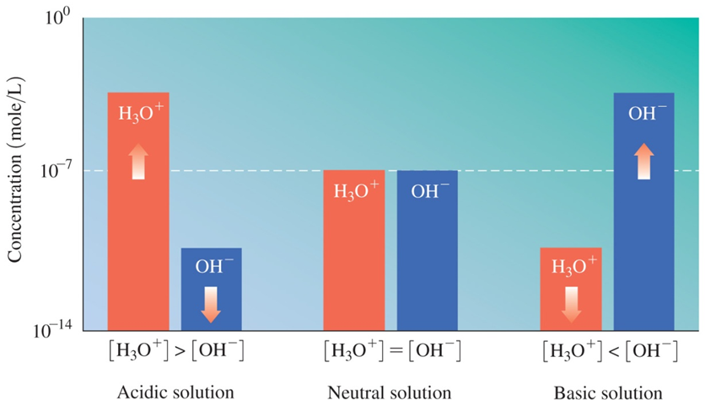
10.5 Dissociation of Water
Learning Goal Use the water dissociation expression to calculate the [H ₃ O⁺] and [O H⁻] in an aqueous solution.

Slide 62
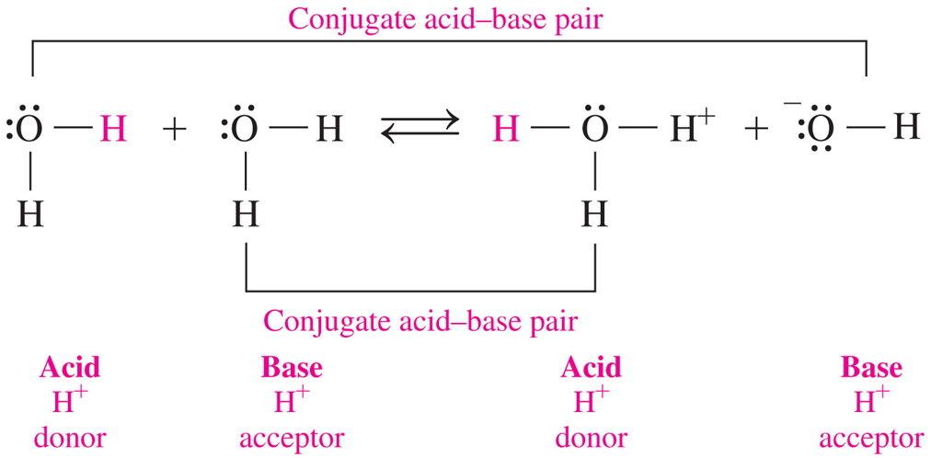
Ionization of Water
Water is amphoteric—it can act as an acid or a base. In water,
H⁺ is transferred from one H ₂ O molecule to another
one molecule acts as an acid, while another acts as a base
equilibrium is reached between the conjugate acid–base pairs

Slide 63
Writing the Water Dissociation Expression, K _{w}
In the equation for the dissociation of water, there is both a forward and a reverse reaction.
In pure water, the concentrations of H ₃ O⁺ and O H⁻ at 25 °C
are each

Slide 64
Water Dissociation Expression, K _{w}
The water dissociation expression, K _{w}, is defined
as the product of the concentrations of H ₃ O⁺ and O H⁻
as equal to
at 25 °C (the concentration units
are omitted)
When
the [H ₃ O⁺] and [O H⁻] are equal, the solution is neutral
the [H ₃ O⁺] is greater than the [O H⁻], the solution is acidic
the [O H⁻] is greater than the [H ₃ O⁺], the solution is basic

Slide 65
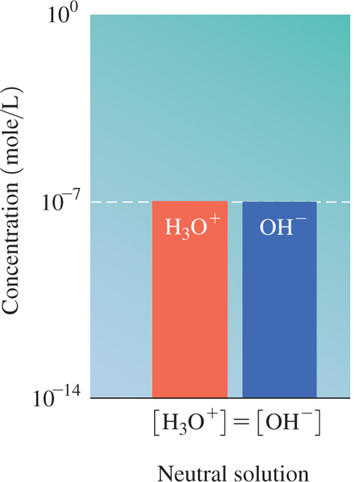
Pure Water Is Neutral
In pure water, the ionization of water molecules produces small but equal quantities of H ₃ O⁺ and O H⁻ ions.
[H ₃ O⁺] = [O H⁻]
Pure water is neutral.

Slide 66
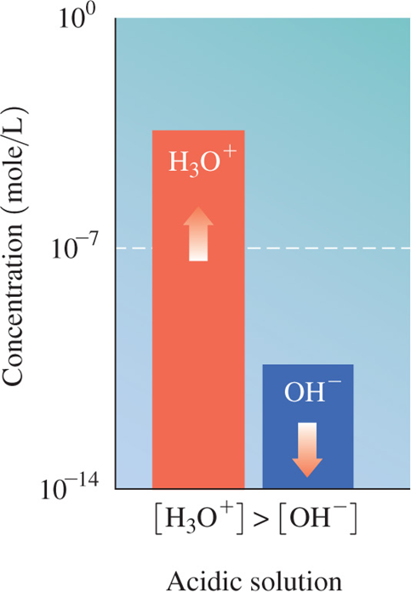
Acidic Solutions
Adding an acid to pure water
increases the [H ₃ O⁺]
causes the [H ₃ O⁺] to exceed
decreases the [O H⁻]
[H ₃ O⁺] > [O H⁻]
The solution is acidic.

Slide 67
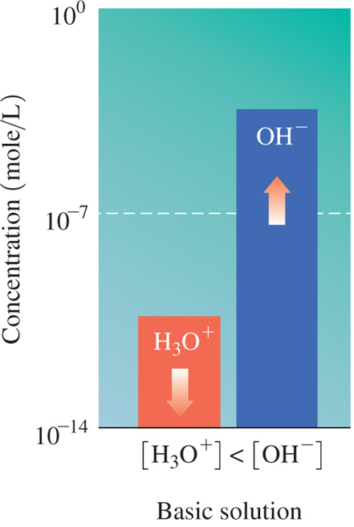
Basic Solutions
Adding a base to pure water
increases the [O H⁻]
causes the [O H⁻] to exceed
decreases the [H ₃ O⁺]
[H ₃ O⁺] < [O H⁻]
The solution is basic.

Slide 68
Comparison of [H ₃ O⁺] and [O H⁻]

Slide 69
Neutral, Basic, and Acidic Solutions
Table 10.5 Examples of [H ₃ O⁺] and [O H⁻] in Neutral, Acidic, and Basic Solutions

Slide 70
Using K _{w} to Calculate [H ₃ O⁺] and [O H⁻]
If we know the [H ₃ O⁺] of a solution, we can use the K _{w} to calculate the [O H⁻].
If we know the [O H⁻] of a solution, we can use the K _{w} to calculate the [H ₃ O⁺].

Slide 71
Calculating [H ₃ O⁺] (1 of 2)
What is the [H ₃ O⁺] of a solution if [O H⁻] is
Solution:
Step 1 State the given and needed quantities.
Analyze the Problem | Given | Need | Connect
Analyze the Problem | Concentration of O H minus = 5.0 times 10 raised to the negative eighth power molarity. | [H ₃ O⁺] | K _{w} = [H ₃ O⁺][O H⁻]
Step 2 Write the K _{w} for water and solve for the unknown [H ₃ O⁺] or [O H⁻].

Slide 72
Calculating [H ₃ O⁺] (2 of 2)
What is the [H ₃ O⁺] of a solution if [O H⁻] is
Step 3 Substitute in the known [H ₃ O⁺] or [O H⁻] and calculate.
Because the
is larger than the
the solution is acidic.

Slide 73
Learning Check 1
If lemon juice has [H ₃ O⁺] of
what is the [O H⁻]
of the solution?
A.
B.
C.

Slide 74
Solution 1 (1 of 2)
If lemon juice has [H ₃ O⁺] of
what is the [O H⁻] of
the solution?
Step 1 State the given and needed quantities.
Analyze the Problem | Given | Need | Connect
Analyze the Problem | Concentration of H 3 O plus = 2.0 times 10 raised to the negative third power molarity. | [O H⁻] | K _{w} = [H ₃ O⁺][O H⁻]
Step 2 Write the K _{w} for water and solve for the unknown [H ₃ O⁺] or [O H⁻].

Slide 75
Solution 1 (2 of 2)
If lemon juice has [H ₃ O⁺] of
what is the [O H⁻] of
the solution?
Step 3 Substitute in the known [H ₃ O⁺] or [O H⁻] and calculate.
Because the [H ₃ O⁺] concentration of
is greater
than the [O H⁻] of
the solution is acidic.
The answer is C.

Slide 76
10.6 The p H Scale
The p H scale is used to describe the acidity of solutions.
The p H of Diet Coke is 3.17.
Learning Goal Calculate the p H of a solution from
given the p H, calculate

Slide 77
The p H Scale (1 of 2)
The p H of a solution
is used to indicate the acidity of a solution
has values that usually range from 0 to 14
is acidic when the values are less than 7
is neutral at a value of 7
is basic when the values are greater than 7

Slide 78
The p H Scale (2 of 2)
The p H of a solution is commonly measured using
a p H meter in the laboratory
p H paper, an indicator that turns specific colors at specific p H values
The p H of a solution is found by comparing the colors of indicator paper to a chart.

Slide 79
p H Measurement
The p H of a solution can be determined using (a) a p H meter, (b) p H paper, and (c) indicators that turn different colors corresponding to different p H values.

Slide 80
p H of Common Substances
On the p H scale, values below 7.0 are acidic, a value of 7.0 is neutral, and values above 7.0 are basic.
Notes:
On the scale, p H below 7 is acidic, p H at 7 is neutral, and p H above 7 is basic. p H values of a variety of items are identified on the scale, as follows.
• 1 molar H C l solution 0.0.
• Gastric juice 1.6
• Lemon juice 2.2
• Vinegar 2.8
• Carbonated beverage 3.0
• Orange 3.5
• Apple juice 3.8
• Tomato 4.2
• Coffee 5.0
• Bread 5.5
• Potato 5.8
• Urine 6.0
• Milk 6.4
• Water, pure, 7.0
• Drinking water 7.2
• Blood plasma 7.4
• Seawater 8.5
• Milk of magnesia 10.5
• Ammonia 11.0
• Bleach 12.0
• 1 M, N a O H solution, lye, 14.0

Slide 81
Learning Check 1
Identify each solution as acidic, basic, or neutral.
A. Fill in the blank H C l with a p H = 1.5
B. Fill in the blank pancreatic fluid,
C. Fill in the blank Sprite soft drink, p H = 3.0
D. Fill in the blank p H = 7.0
E. Fill in the blank
F. Fill in the blank

Slide 82
Solution 1
Identify each solution as acidic, basic, or neutral.
A. Fill in the blank H C l with a p H = 1.5
acidic
B. Fill in the blank pancreatic fluid,
basic
C. Fill in the blank Sprite soft drink, p H = 3.0
acidic
D. Fill in the blank p H = 7.0
neutral
E. Fill in the blank
acidic
F. Fill in the blank
basic

Slide 83
Calculating the p H of Solutions
The p H scale
is a logarithmic scale that corresponds to the
aqueous solutions.
is the negative logarithm (base 10) of the
To calculate the p H, the negative powers of 10 in the molar
concentrations are converted to positive numbers. If

Slide 84
p H, Significant Figures
To determine the number of significant figures in the p H value, consider the following:
The number of decimal places in the p H value is the same as the number of significant figures in the coefficient of
The number to the left of the decimal point in the p H value is the power of 10.
Notes:
The p H = 2.00. In the concentration of H 3 O plus, the coefficient 1.0 has 2 significant figures, therefore the p H value has 2 significant figures to the right of the decimal point. The power of 10 in the concentration of H 3 O plus is negative 2, therefore the number to the left of the decimal in the p H value is also 2.

Slide 85
p H Scale and concentration H sub 3 O super plus
Because p H is a log scale,
a change of one p H unit corresponds to a tenfold change
p H decreases as the

Slide 86
p H Calculation (1 of 5)
Aspirin, which is acetylsalicylic acid, was the first nonsteroidal anti-inflammatory drug used to alleviate pain
and fever. If a solution of aspirin has a
what is the p H of the solution?

Slide 87
p H Calculation (2 of 5)
If a solution of aspirin has a
what is
the p H of the solution?
Solution:
Step 1 State the given and needed quantities.
Analyze the Problem | Given | Need | Connect
blank | Concentration of H 3 O plus = 1.7 times 10 raised to the negative third power molarity | p H | p H equation

Slide 88
p H Calculation (3 of 5)
If a solution of aspirin has a
what is
the p H of the solution?
Step 2 Enter the
into the p H equation and
calculate.
Procedure: Enter 1.7 and press
Calculator Display:
Enter 3 and press
to change sign.
Calculator Display:

Slide 89
p H Calculation (4 of 5)
If a solution of aspirin has a
what is
the p H of the solution?
Step 2 Enter the
into the p H equation and
calculate.
Procedure:

Slide 90
p H Calculation (5 of 5)
If a solution of aspirin has a
what is
the p H of the solution?
Step 3 Adjust the number of S F s on the right of the decimal point.
Notes:
10 raised to the negative third power molarity is in a power of ten and is exact. H = negative log, left bracket, 1.7 times 10 raised to the negative third power, right bracket, = 2.77. 10 raised to the negative third power is exact and 2.77 is two S F's.

Slide 91
Learning Check 2
Find the p H of a solution with a

Slide 92
Solution 2 (1 of 4)
Find the p H of a solution with a
Solution:
Step 1 State the given and needed quantities.
Analyze the Problem | Given | Need | Connect
Analyze the Problem | Concentration of H 3 O plus = 4.0 times 10 raised to the negative fifth power molarity. | p H | p H equation

Slide 93
Solution 2 (2 of 4)
Find the p H of a solution with a
Step 2 Enter the
into the p H equation and
calculate.
Procedure: Enter 4.0 and press
Calculator Display:
Enter 5 and press
to change sign.
Calculator Display:

Slide 94
Solution 2 (3 of 4)
Find the p H of a solution with a
Step 2 Enter the
into the p H equation and
calculate.
Procedure:

Slide 95
Solution 2 (4 of 4)
Find the p H of a solution with a
Step 3 Adjust the number of S F s on the right of the decimal point.
Notes:
10 raised to the negative fifth power molarity is a power of ten and exact. p H = negative log, left bracket, 4.0 times 10 raised to the negative fifth power, right bracket, = 4.40. 10 raised to the negative fifth power is exact and 4.40 is two S F's.

Slide 96
Calculating concentration H sub 3 O super plus from p H
Given the p H of a solution, we can reverse the calculation to
obtain the
For whole number p H values, the negative p H value is the
power of 10 in the
For p H values that are not whole numbers, the calculation
requires the use of the
key, which is usually a 2nd
function key.

Slide 97
Learning Check 3
Determine the
for solutions having each of the
following p H values:
A. 3.0
B. 3.42

Slide 98
Solution 3 (1 of 4)
Determine the
for solutions having each of the
following p H values:
A. 3.0 For p H values that are whole numbers, the
can be written

Slide 99
Solution 3 (2 of 4)
Determine the
for solutions having each of the
following p H values:
B. 3.42 For p H values that are not whole numbers, do the following:
Step 1 State the given and needed quantities.
Analyze the Problem | Given | Need | Connect
blank | p H = 3.42 | concentration H sub 3 O super plus | Concentration of H 3 O plus = 10 raised to the negative p H power. 10 raised to the negative p H power.
3.42
Calculator Display: −3.42

Slide 100
Solution 3 (3 of 4)
Determine the
for solutions having each of the
following p H values:
B. 3.42 For p H values that are not whole numbers, do the following:
Step 2 Enter the p H value into the inverse log equation and calculate.
Press the 2nd function key and then the
Or press the inverse key and then the log key.

Slide 101
Solution 3 (4 of 4)
Determine the
for solutions having each of the
following p H values:
B. 3.42 For p H values that are not whole numbers, do the following:
Step 3 Adjust the S Fs for the coefficient.
The p H value of 3.42 has two digits on the right of the
decimal point; the
is written with two significant
figures in the coefficient.

Slide 102
concentration H sub 3 O super plus, concentration O H super minus and p H Comparison
Table 10.6 A Comparison of
and Corresponding
p H Values
Notes:
Entries above this value on the table are acidic. Entries below this value on the table are basic.
Concentration of H 3 O plus p H Concentration of O H minus
ten to the zero power 0 ten to the negative fourteenth power
ten to the negative first power 1 ten to the negative thirteenth power
ten to the negative second power 2 ten to the negative twelfth power
ten to the negative third power 3 ten to the negative eleventh power
ten to the negative fourth power 4 ten to the negative tenth power
ten to the negative fifth power 5 ten to the negative ninth power
ten to the negative sixth power 6 ten to the negative eighth power
ten to the negative seventh power 7 ten to the negative seventh power
ten to the negative eighth power 8 ten to the negative sixth power
ten to the negative ninth power 9 ten to the negative fifth power
ten to the negative tenth power 10 ten to the negative fourth power
ten to the negative eleventh power 11 ten to the negative third power
ten to the negative twelfth power 12 ten to the negative second power
ten to the negative thirteenth power 13 ten to the negative first power
ten to the negative fourteenth power 14 ten to the zero power

Slide 103
10.7 Reactions of Acids and Bases
Gastric acid contains H C l and is produced by parietal cells that line the stomach. When protein enters the stomach, H C l is secreted until the p H reaches 2, optimum for digestion.
Learning Goal Write balanced equations for reactions of acids with metals, carbonates or bicarbonates, and bases; calculate the molarity or volume of an acid from titration information.
Notes:
An enlargement of the stomach lining shows the embedded gastric glands, which are lined with epithelial cells, parietal cells, and mucous cells toward the interior, and also with chief cells closer to the exterior.

Slide 104
Reactions of Acids
Acids react with
certain metals to produce a salt and hydrogen gas
bases to produce a salt and water
bicarbonate and carbonate ions to produce carbon dioxide gas
A salt is an ionic compound that does not have
as the cation or
as the anion.

Slide 105
Acids and Metals
Acids react with metals
such as K, N a, C a, M g, A l, Z n, F e, and S n
to produce hydrogen gas and the salt of the metal

Slide 106
Learning Check 1
Write balanced equations and label the metal, acid, and salt for the following reactions:
A. Magnesium metal with H C l(aqueous)
B. Aluminum metal with

Slide 107
Solution 1
Write balanced equations and label the metal, acid, and salt for the following reactions:
A. Magnesium metal with H C l(aqueous)
B. Aluminum metal with

Slide 108
Acids, Carbonates, Bicarbonates
Acids react
with carbonates and hydrogen carbonates
to produce carbon dioxide gas, a salt, and water

Slide 109
Learning Check 2
Write balanced equations for the following reactions:
A.
B.

Slide 110
Solution 2
Write balanced equations for the following reactions:
A.
B.

Slide 111
Acids and Hydroxides: Neutralization
In a neutralization reaction,
an acid reacts with a base to produce a salt and water
the salt formed is the anion from the acid and the cation from the base

Slide 112
Neutralization Reactions
In neutralization reactions, one
always reacts with one
If we write the strong acid and strong base as ions, we see
to form water, leaving the ions
The overall reaction occurs as the
from the acid and
from the base form water:

Slide 113
Balancing Neutralization Reactions (1 of 2)
Write the balanced equation for the neutralization of solid magnesium hydroxide and nitric acid.
Analyze the Problem | Given | Need | Connect
blank | M g left parenthesis O H right parenthesis sub 2, H N O sub 3 | balanced equation | neutralization products
Step 1 Write the reactants and products.
Step 2 Balance the
in the acid with the
base.

Slide 114
Balancing Neutralization Reactions (2 of 2)
Write the balanced equation for the neutralization of solid magnesium hydroxide and nitric acid.
Step 3 Balance the
Step 4 Write the formula of the salt from the remaining ions.

Slide 115
Learning Check 3
Select the correct group of coefficients for each of the following neutralization equations.
1.
A. 1, 3, 3, 1
B. 3, 1, 1, 1
C. 3, 1, 1, 3
2.
A. 3, 2, 2, 2
B. 3, 2, 1, 6
C. 2, 3, 1, 6

Slide 116
Solution 3 (1 of 4)
Select the correct group of coefficients for each of the following neutralization equations.
Step 1 Write the reactants and products.
1.
2.

Slide 117
Solution 3 (2 of 4)
Select the correct group of coefficients for each of the following neutralization equations.
Step 2 Balance the
in the acid with the
base.
1.
2.

Slide 118
Solution 3 (3 of 4)
Select the correct group of coefficients for each of the following neutralization equations.
Step 3 Balance the
1.
2.

Slide 119
Solution 3 (4 of 4)
Select the correct group of coefficients for each of the following neutralization equations.
Step 4 Write the salt from the remaining ions.
1.
The answer is C, 3, 1, 1, 3.
2.
The answer is B, 3, 2, 1, 6.

Slide 120
Acid–Base Titration (1 of 2)
Titration
is a laboratory procedure used to determine the molarity of an acid
uses a base such as N a O H to neutralize a measured volume of an acid
requires a few drops of an indicator such as phenolphthalein to identify the endpoint

Slide 121
Acid–Base Titration (2 of 2)
In the following titration, a specific volume of acidic solution is titrated to the endpoint with a known concentration of N a O H.

Slide 122
Indicator
The indicator phenolphthalein
is added to identify the endpoint
turns pink when the solution is neutralized

Slide 123
Endpoint of Titration
At the endpoint,
the moles of base are equal to the moles of acid in the solution
the concentration of the base is known
the volume of the base used to reach the endpoint is measured
the molarity of the acid is calculated using the neutralization equation for the reaction

Slide 124
Acid–Base Titration Calculations (1 of 4)
What is the molarity of an H C l solution if 18.5 milliLiter of 0.225 Molarity N a O H is required to neutralize 0.0100 Liter of H C l?
Solution:
Step 1 State given and needed quantities and concentrations.
Analyze the Problem | Given | Need | Connect
Analyze the Problem | 18.5 milliLiterof 0.225 Molarity N a O H 0.0100 Liter H C l | molarity of H C l solution | molarity, mole–mole factor

Slide 125
Acid–Base Titration Calculations (2 of 4)
What is the molarity of an H C l solution if 18.5 milliLiter of 0.225 Molarity N a O H is required to neutralize 0.0100 Liter of H C l?
Step 2 Write a plan to calculate molarity or volume.
Notes:
That is converted through molarity to moles of N a O H, which then go through a mole-mole factor to become moles of H C l. Those are divided by liters to give molarity of H C l solution.

Slide 126
Acid–Base Titration Calculations (3 of 4)
What is the molarity of an H C l solution if 18.5 milliLiter of 0.225 Molarity N a O H is required to neutralize 0.0100 Liter of H C l?
Step 3 State equalities and conversion factors including concentrations.

Slide 127
Acid–Base Titration Calculations (4 of 4)
What is the molarity of an H C l solution if 18.5 milliLiter of 0.225 Molarity N a O H is required to neutralize 0.0100 Liter of H C l?
Step 4 Set up the problem to calculate the needed quantity.

Slide 128
Learning Check 4
What is the molarity of an H C l solution if 25.5 milliLiter of 0.438 Molarity N a O H is required to neutralize 0.0250 Liter of H C l?

Slide 129
Solution 4 (1 of 4)
What is the molarity of an H C l solution if 25.5 milliLiter of 0.438 Molarity N a O H is required to neutralize 0.0250 Liter of H C l?
Step 1 State given and needed quantities and concentrations.
Analyze the Problem | given | need | Connect
Analyze the Problem | 25.5 milliLiter of 0.438 Molarity N a O H 0.0250 Liter H C l | molarity of H C l solution | molarity, mole-mole factor

Slide 130
Solution 4 (2 of 4)
What is the molarity of an H C l solution if 25.5 milliLiter of 0.438 Molarity N a O H is required to neutralize 0.0250 Liter of H C l?
Step 2 Write a plan to calculate molarity or volume.
Notes:
That is converted through molarity to moles of N a O H, which then go through a mole-mole factor to become moles of H C l. Those are divided by liters to give molarity of H C l solution.

Slide 131
Solution 4 (3 of 4)
What is the molarity of an H C l solution if 25.5 milliLiter of 0.438 Molarity N a O H is required to neutralize 0.0250 Liter of H C l?
Step 3 State equalities and conversion factors including concentrations.

Slide 132
Solution 4 (4 of 4)
What is the molarity of an H C l solution if 25.5 milliLiter of 0.438 Molarity N a O H is required to neutralize 0.0250 Liter of H C l?
Step 4 Set up the problem to calculate the needed quantity.

Slide 133
Chemistry Link to Health: Antacids (1 of 2)
Antacids are substances that
are used to neutralize excess stomach acid
are often made of aluminum hydroxide and magnesium hydroxide mixtures
These hydroxides are not very soluble in water, so the
levels of available
not damaging to the intestinal tract.

Slide 134
Chemistry Link to Health: Antacids (2 of 2)
Basic Compounds in Antacid Tablets:
Table 10.7 Basic Compounds in Some Antacids
Antacid | Base(s)
Amphojel | A l left parenthesis O H right parenthesis sub 3
Milk of magnesia | M g left parenthesis O H right parenthesis sub 2
Mylanta, Maalox, Di-Gel, Gelusil, Riopan | M g left parenthesis O H right parenthesis sub 2, A l left parenthesis O H right parenthesis sub 3
Bisodol, Rolaids | C a C O sub 3, M g left parenthesis O H right parenthesis sub 2
Titralac, Tums, Pepto-Bismol | _{C a C O sub 3}
Alka-Seltzer | _{N a H C O sub 3, K H C O sub 3}

Slide 135
10.8 Buffers
A buffer solution maintains the p H by neutralizing small amounts of added acid or base.
An acid must be present to react with any
added, and
a base must be present to react with any
Learning Goal Describe the role of buffers in maintaining the p H of a solution.

Slide 136
Buffers
When an acid or base is added to water, the p H changes drastically.
In a buffer solution, the p H is maintained; the p H does not change when acid or base is added.
Notes:
H 3 O plus, or O H minus, is added to each sample. The results are as follows.
● The original water sample p H = 7.0. H 3 O plus addition results in p H = 4.0. O H minus addition results in p H = 10.5.
● The original buffer sample p H = 7.0. H 3 O plus addition results in p H = 6.9. O H minus addition results in p H = 7.1.

Slide 137
How Buffers Work (1 of 2)
Buffers work because
they resist changes in p H from the addition of acid or base
in the body, they absorb
from foods and
cellular processes to maintain p H
they are important in the proper functioning of cells and blood
they maintain a p H close to 7.4 in blood
A change in the p H of the blood affects the uptake of oxygen and cellular processes.

Slide 138
Components of a Buffer
A buffer solution
contains a combination of acid–base conjugate pairs, a weak acid and a salt of its conjugate base such as
has equal concentrations of a weak acid and its salt

Slide 139
How Buffers Work (2 of 2)
In the buffer with acetic acid
and sodium acetate
the salt produces acetate ions and sodium ions
the salt is added to provide a higher concentration of the
conjugate base
than from the weak acid alone

Slide 140
Function of a Weak Acid in a Buffer
The function of the weak acid in a buffer is to neutralize a base.
The acetate ion produced in the neutralization reaction adds to the concentration of acetate already in solution from the salt.

Slide 141
Function of Conjugate Base in a Buffer
The function of the acetate ion,
is to neutralize
from acids.
The acetic acid produced contributes to the available weak acid.

Slide 142
Working Buffers
Buffers work because the weak acid in a buffer neutralizes bases and the conjugate base in the buffer neutralizes acids.
The buffer described here consists of about equal concentrations of acetic acid
and its conjugate base, acetate ion
Adding
to the buffer reacts with
whereas adding
The p H of the solution is maintained as long as the added amounts of acid or base are small compared to the concentrations of the buffer components.
Notes:
Adding H 3 O plus increases the concentration of the weak acid and decreases the concertation of the conjugate base. Adding O H minus increases the concentration of the conjugate base and decreases the concentration of the weak acid.

Slide 143
Learning Check 1
Which of the following combinations make a buffer solution?
A. H C l and K C l
B.
C.
D.

Slide 144
Solution 1
Which of the following combinations make a buffer solution?
A buffer consists of a weak acid and a salt of its conjugate base.
A. H C l and K C l
not a buffer
B.
buffer, a weak acid and its salt
C.
not a buffer
D.
buffer, a weak acid and its salt

Slide 145
Acids and Bases—Concept Map
Notes:
• An acid is an H plus donor. Acids that dissociate 100 percent are strong acids and those that dissociate a small percentage are weak acids.
• A base is an H plus acceptor. Bases that dissociate 100 percent are strong bases and those that dissociate a small percentage are weak bases.
• Weak acids and weak bases involve reversible reactions that reach equilibrium, which adjusts for change in concertation according to Le Châtelier’s principle.
• In acids and bases, dissociation of H 2 O gives H 3 O plus and O H minus. H 3 O plus gives the negative log of the concentration of H 3 O plus, which is the p H. The products H 3 O plus and O H minus have a K sub W value equal to concentration of H 3 O plus, times the concentration of O H minus.
• Acids and bases undergo neutralization to form water and salt. The salt of a weak acid or base forms a buffer with its conjugate to maintain p H.

